Slide 1

Team: Less is More
Perry Spyropoulos Ryan Moore
Carlynn Evanoff Andrew Bissada

Slide 2
It’s an Open Source Search Engine Library, released under the GPL. It is written primarily in C++ but it has bindings that allow use from Perl, Python, PHP, Java, Tcl, C# and Ruby.
It allows developers to easily add advanced indexing and search facilities to their own applications.

Slide 3
Features
Highly Portable → (runs on Linux, Mac OS X, Windows, and Unix Platforms)
Written in C++ but has available bindings for many languages such as Python
Ranked Searching → important words get more weight than unimportant words
Relevance Feedback → given one or more documents, Xapian can suggest the most relevant index terms to expand query
Phrase & Proximity Searching → users can search for words occurring in an exact phrase or within a specified number of words, in a specified order, or in any order
Boolean search operators → ranked by probabilistic weights
Stemming of search terms → helps to find relevant documents which might otherwise be missed (search for “football” would match docs that mention “footballs” or “footballer”
Wildcard Searching
Synonyms → supported explicitly (“~cash”) and as an automatic form of query expansion
Suggests spelling corrections for user supplied queries
Supports database files (can also build a database on one machine and search it on another
Allows simultaneous update and searching. New docs become searchable right away.

Slide 4
TEST PLAN :
Testing Process → tested different types of searches and possibly the interface
Requirements Tractability → separate test cases and databases for each feature to isolate each feature then run the test on it
Tested Items → tested documents such as office, sequel, databases and run all of the different types of searches listed in features
Testing Schedule → First 2 weeks (set up the test driver), 1 week (test the driver and create the module to test it before instead of testing at the end), upon test driver completion (finish 2 test cases per week)
Test Recording Procedures → recorded to a text doc a log of the tests run and whether they passed or not
Constraints → Lack of familiarity with C++, small staff, lack of familiarity with databases
System Tests → created a module to test the test driver that will make sure it imported correctly and implements a searcher

Slide 5
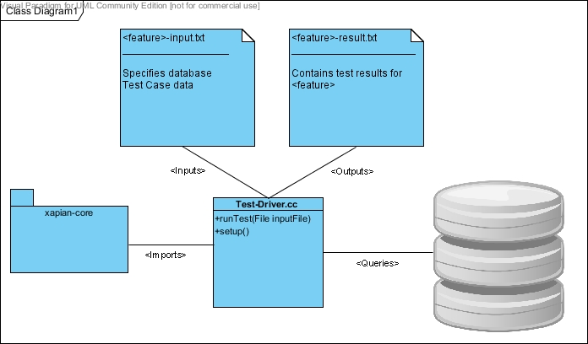
UML Diagram for Design :

Slide 6
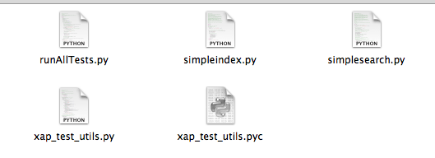
Testing Framework:
Test Driver → runAllTests.py (imports the indexer searcher and accepts the test files. Parses the data and the test cases from each input file. Uses specified database to query and inspect the results. Outputs the results from test to a text file for each input file)
3 Main Methods →
getInputFiles
getData (setup phase)
runTest (calls and asserts)
The xap_test_utils.py holds the helper utilities used by the main runAllTests.py file.

Slide 7
Fault Insertion / Features Disabled :
1. Wildcard
2. Synonyms
3. Spelling Corrections
4. Partial Words
5. Boolean NOT

Slide 8
LESSONS LEARNED :
New Environment
Had to learn the Unix enviroment which included navigating directories, and learning the commands to execute desired functions.
Combining Team Skills
Each team member possessed a different skill which was essential to achieving the final product. You had to recognize where the strengths were, make use of those, while also strengthening their weaknesses.
Time Management
Leaving an adequate amount of time for each deadline to assess problems, work through them, and create a professional final submission

